Slide 1

Toni Lurz
Final Presentation for Data Science January 09, 2020
This Photo by Unknown Author is licensed under CC BY-NC
Notes:
Welcome Everyone and Thank you all for coming today.

Slide 2


Introduction
Notes:
Welcome everyone and thank you all for being here today. My name ins Antoinette Lurz but I prefer being called Toni, a little less formal. I live in Nebraska and am always required to display patronage to the Huskers. I am a mother, grandmother and wife of a school employee. These are some of the reasons we here today looking at public schools. I started college two different times throughout the years and I was looking for something more again. I wanted more technical skills rather than just theory. After being in the workforce and seeing that skills are very important when looking for a change I found this program.

Slide 3

“Education is the most powerful weapon which you can use to change the world.” - Nelson Mandela

Slide 4

Public Schools: How can Data help create the best schools
Antoinette “Toni” Lurz | 1/9/2020
Notes:
Welco me Today we are all here to explore how you can use data will help elevate Public School to an even higher degree .

Slide 5

What to Ask First
How does a school become a leading school?
What is the best way to use data to help?
Looking forward Predictions with Machine Learning
Help Develop stronger faster more accurate decisions
Administrator Decision Makers and Key Stakeholders can have a tool to help
Notes:
Looking from the outside, with kids or a husband in the field, I have always wondered how does a school become a leading school. Is the teacher the sole reason, does leadership really effect the overall school or is a collaboration what matters most. This is what drove me to ask the question. Can data help drive a school to be better? How can we do this with data? I thought lets find a tool that can help administration and stakeholders on make better decisions. Schools use lots of data already so what may be something new, a predictions. Performance levels are what shows where a school preforms, so why not find what data is needed and be able to predict where a school will start and grow to in these levels. By predicting where a new school or transforming school will start their performance level at administration and stake holders can make better decisions. Also the prediction can help develop stronger schools faster and allow students to be better served.

Slide 6

Can we predict the Performance Level of a school using a defined group of predetermined data?
This Photo by Unknown Author is licensed under CC BY-SA

Slide 7
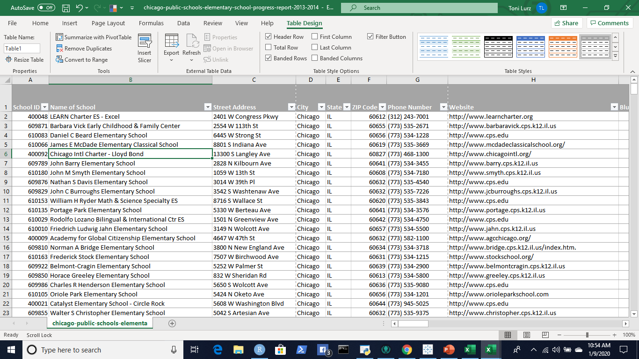
Kaggle Data
Chicago Public Schools Elementary Performance Data 2012-2013
Large Diversity and Representation
484 Schools
50 Zip Codes
Less Bias and more accurate data
Notes:
Now finding the right data for the project is the next step for me. I started at the website Kaggle and found what I was looking for. I chose Chicago Public Schools. Chicago has a large population with a diverse groups of people. The schools in this data lone are 484 schools within 50 different zip codes . This Chicago Schools data set will be a better representation of more groups and also be less bias then smaller community with less. I also needed the scale to be smaller so I chose the Elementary system as they have a few less classes and test to differentiate the schools with.

Slide 8

Chicago Public School Performance
https://cps.edu/Performance/Documents/SQRPHandbook_SY19-20.pdf
Notes:
Now we can take a quick look at what is the performance levels of the Chicago Public schools. This is the current information that we can find online. As we look through out the data we can find the Policy Performance Levels and how they relate to the data. This example is the current system which has some adjustments since the data we are using today. There are more levels along with other changes but what you see is how the levels rank So as I already could decipher Level 1 is the highest , Level 2 is emerging and Level 3 needs the most improvement.

Slide 9
The Charts and Graphs
Notes:
This bar graph example shown here is has some interesting information. You think that attendance is always higher the higher the level school. You would be wrong, Level two has the highest attendance. I was surprised and interested even more. This really makes the data interesting and makes analyzing the data fun. Maybe just for me but I got excited to see more.

Slide 10
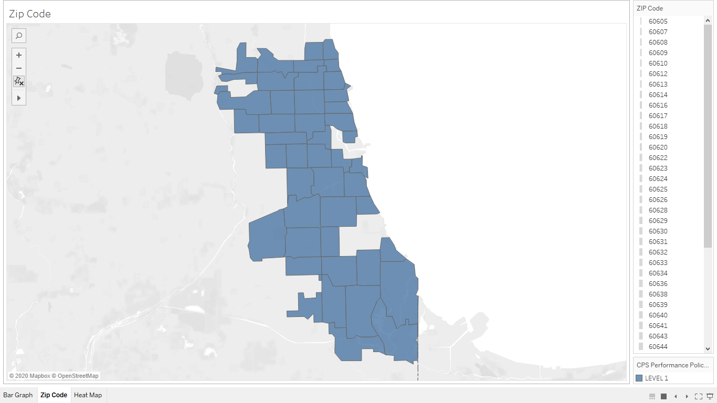
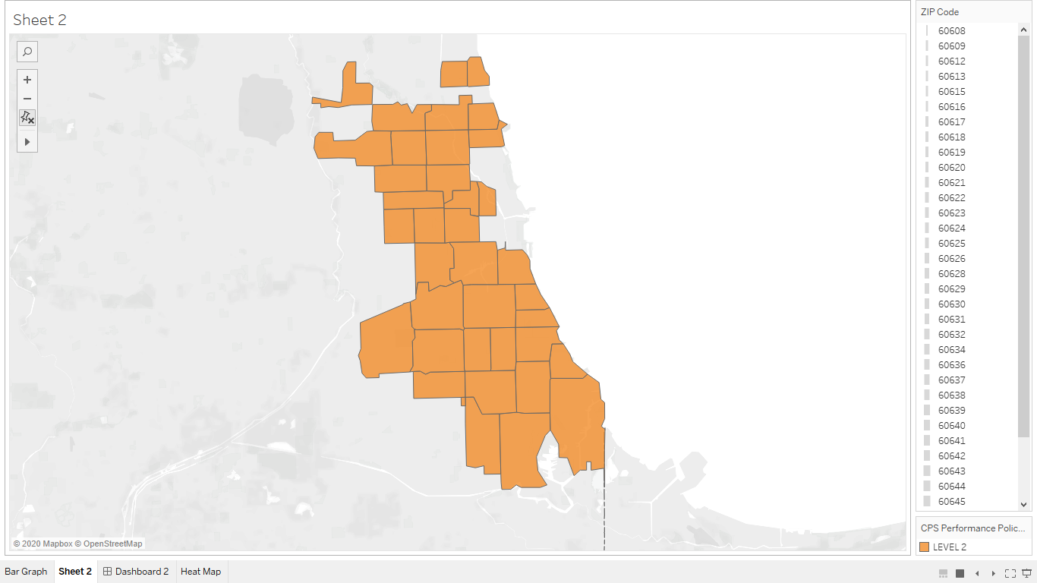
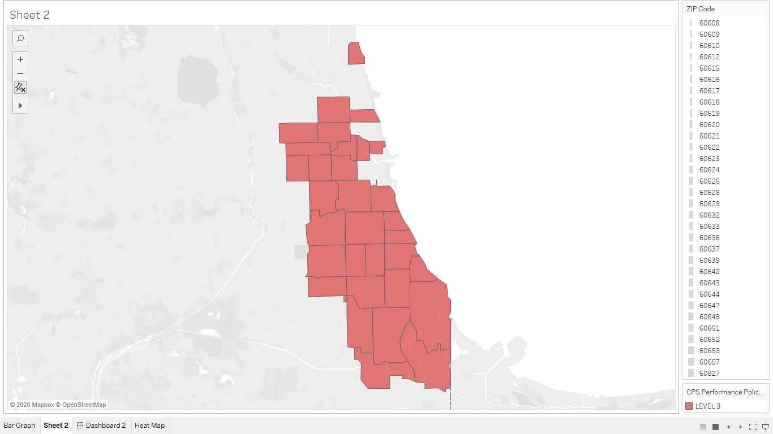

Slide 11
Methods and Programs
Redundant Data
Python
R
Tableau
Excel
Regression Models
Machine Learning Algorithms
Notes:
How did I come up with the data I wanted to use and what was the outcome. I started the evaluation with just some overall common sense. A few of the categories where redundant so I remove these first. Next up was writing some code. I like R for statistics so here is where I went. First is making sure the data can be used. With Kaggle data there is not much that needs to be done just changing some of the values and removing values that do not work.

Slide 12
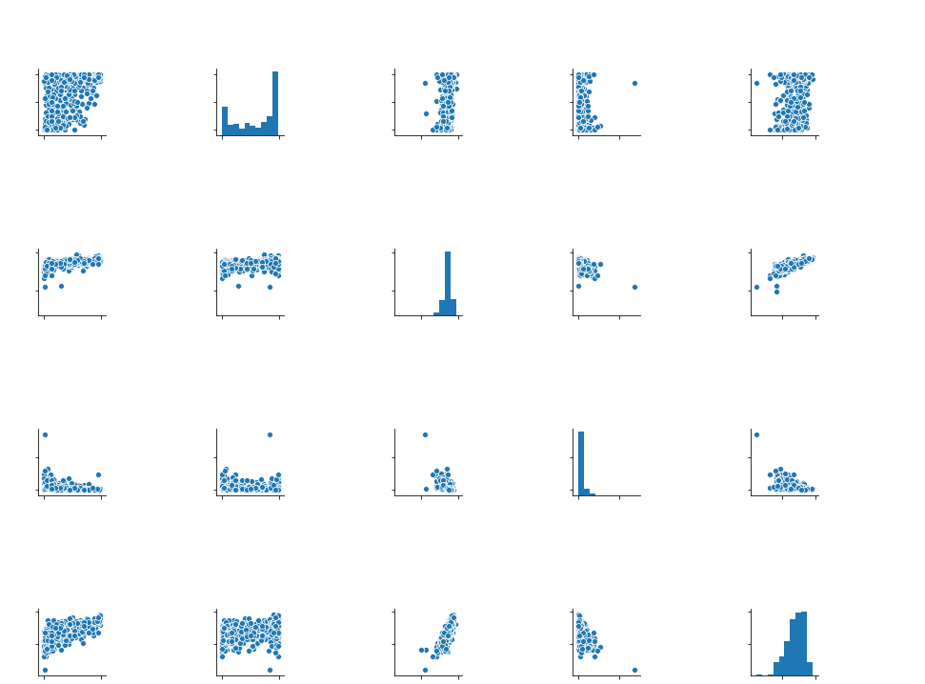
Data Wrangling and Models
Wrangling Data
Stepwise Regression
Forward and
Backward
Notes:
Starting with this group of plots and graphs called Pair plot, you can see that the data relates to each other. There is a bell shape to the middle histograms. Although the bell shape is not as good as I would have like the data still shows what I need. This is a good set of data to use and I moved forward to analysis. Also just looking at the rows and columns in excel you can see that there are a few categories that are redundant data and you can remove these without much programming. Within both R and Python you have the capability to change data and with this analysis I remove nulls and redundant data in both r and Python. Within R I need to prepare the data for the regression models and did this by changing values and removing nulls and data that were not needed. Now for the Stepwise regression models to find the data to use. There are two types that I used. The forward and backward models. These both do so much that it makes finding what you need a breeze. After all was ran, I have my data that I need to move to the next step. Student Attendance, Zip code, Math and Reading Attainment Percentage, Math and Science Growth Percentage is what both showed at the most valuable variables.

Slide 13
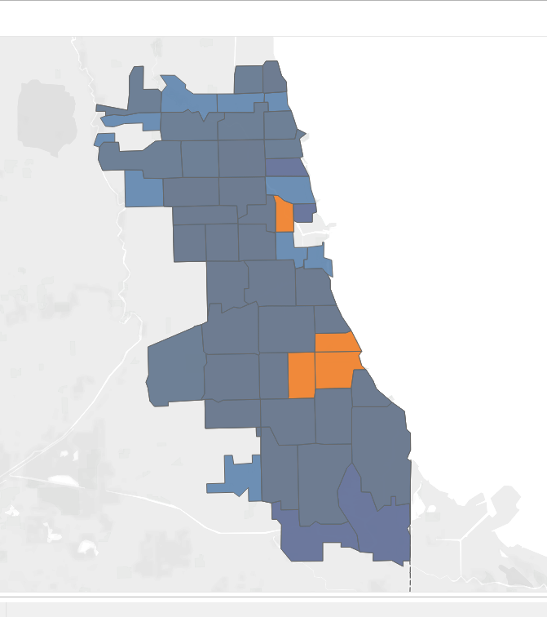
The outcome Data
Creating and building the Stepwise regression models
What was the data we will use
Student Attendance
Zip Code
Math and Reading Attainment Percentage
Math and Reading Growth Percentage

Slide 14
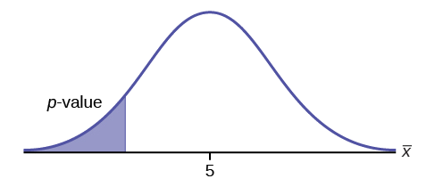
Statistical Analysis in R
p-values tell us whether an observation is as a result of a change that was made or is a result of random occurrences.
R-squared is a statistical measure of how close the data are to the fitted regression line.
P-value = <2.2e-16
Adjusted R-square = 0.6295
Notes:
Starting with the linear regression model, I started to use the data for analysis. I came up with some answers that show promise on the variance in the data. We use some tools in data science that show areas that difference or have a variance. The two most common are Adjusted R-squared and P Values. The p-values here is quite large as the smaller the number the larger that variance. The Adjusted R-squared is the portion of the variance in the dependent variable ( Zip Code , Test Scores, Attendance, etc.) that is based on the independent variable ( Policy Performance Levels) There are many ways which you can find this answer out but I chose to use The adjusted r-square is not bad so this is where we determine if the data is what we need for the models. This so far is headed in the right direction. Next we need find the predetermined set of data to use in our regression models. I really feel that the stepwise regression model are what we should use. The backwards and forward models can rank your specific key elements (data) so you use the most relevant and needed data. You could di a individual models and rank them yourself or let the program do this for you. Sweep your self or use a Roomba, I chose the Roomba.
After running both the forward and backward regression models I found these categories the best to use in the machine learning models.
Student Attendance, Zip Code, Supportive Environment, NWEA Reading and Math Attainment Percentage, NWEA Reading and Math Growth Percentage.

Slide 15
Python
Machine Learning
Supervised Learning Model
K Neighbor
K Means
Decision Tree
Random Forest
Notes:
Python is a vary versatile program. Here I used it strengths in machine learning to develop all the model algorithms so I could create best one with the best outcome. There are five different models that we learned at WOZU. I started with the supervised learning and come up with a good outcome of 68%. But I want to see if I could get even better results. Next in line was the k Means . This was not so good so on to K Neighbors. This model showed more promise and after adjusting the data even further I got better results .I still want to check the last two. I then programed the Decision Tree and Random Forest Models. These both were good but did not beat out the K Neighbor. I have a winner K Neighbor. As I was setting up for the project I really predicted that the Random Forest or Decision Tree might be the best in with this type of data. I was wrong and I am always happy to learn new ideas and be proven wrong, that is how you grow.

Slide 16
Machine Learning Prediction
K Neighbor
Level 1 0.83
Level 2 0.68
Level 3 0.70
weighted avg 0.73
73%
Notes:
There are a few different models in machine learning that you can use. I started with just a standard supervised model that started out the learning not exactly where I wanted it. Next, I tried the K bar, also not as accurate as I would like with a weighted average of 68%. I followed this up with the K Neighbors. This showed more promise. After some adjustments for error I landed at 73% weighted average. Finally I created both the Forest and Decision Making algorithms these both did not have the same precision as the K Neighbor. This was not what I thought was the answer. After creating all the different types of algorithms I found that the K Neighbors is the best model to use. Level 1 (listed at 0.0 is the highest rate at 83%) Level2 = 68%, Level 3 = 70%.

Slide 17

Conclusion
This Photo by Unknown Author is licensed under CC BY
Notes:
What did I learn and create with all this analysis and machine learning. First we created a machine learning algorithm that can help administration and stakeholders in the decision making processes with a 73% accurate prediction of the performance levels I believe that we created a tool with can development the application to add more uses to further the school decision makers. With accurate prediction and the ability to find the right pieces of the puzzle this can help decision making in the public school arena.
I found through analysis that the key components to the performance levels were some predictable and some surprising. Zip code and test scores are easy to understand but a supportive environment over all other areas I could not have predicted myself. As you can see, we can create a machine learning algorithm that can predict a School Level with 73% Weighted average Accuracy . With a model that can not only predict what level a school will be in during the process you find the areas that are the most influence on a school.
This could allow administration and parents find the right fit and enhance a students learning. This program could also help find the right components to build better schools.

Slide 18


Questions

Slide 19


